Slide 1
Group meeting 3 plots of velocities
2021/03/09 Kexin Li

Slide 2
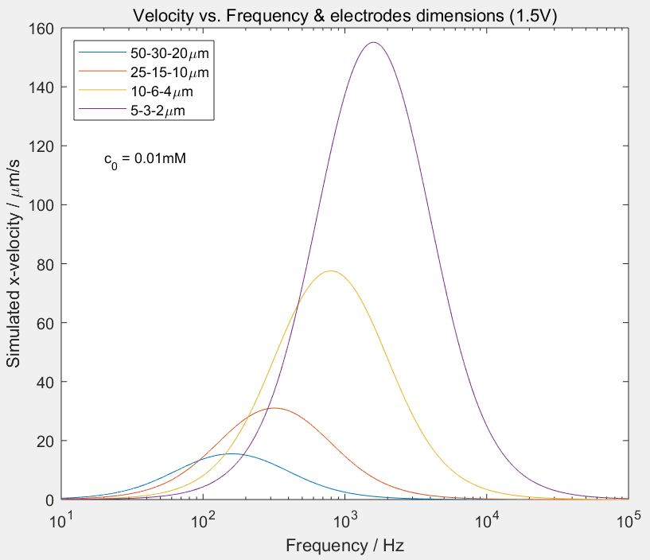
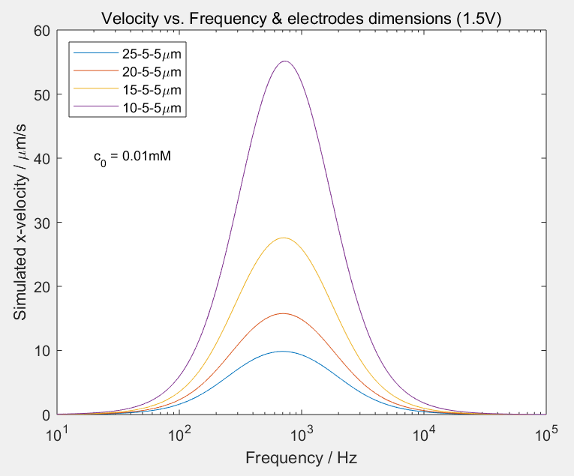

Dependencies (I. frequency & electrodes dimensions) MATLAB simulation
Channel length：3cm
Channel depth：50μm
k = 2.5
k = 2
Principle factors:
Ratio of the electrodes dimension (k = L/S).
Width of the large electrode.
Conclusion: The smaller electrodes generates larger velocities.
*Velocities in the middle of the channel
Notes:
The code for velocity simulation is updated.
Channel length：3cm
Channel depth：50μm

Slide 3
Discussion 1
Why not use the smaller design, while the most experiments choose the dimension of about 20μm width for the large electrode.
Q1: Why not very small?
A1: Limitation from the resolution of the lithographic system.
Q2: Why not smaller size of larger electrode?
A2: Need to generate larger ACEO flow.

Slide 4
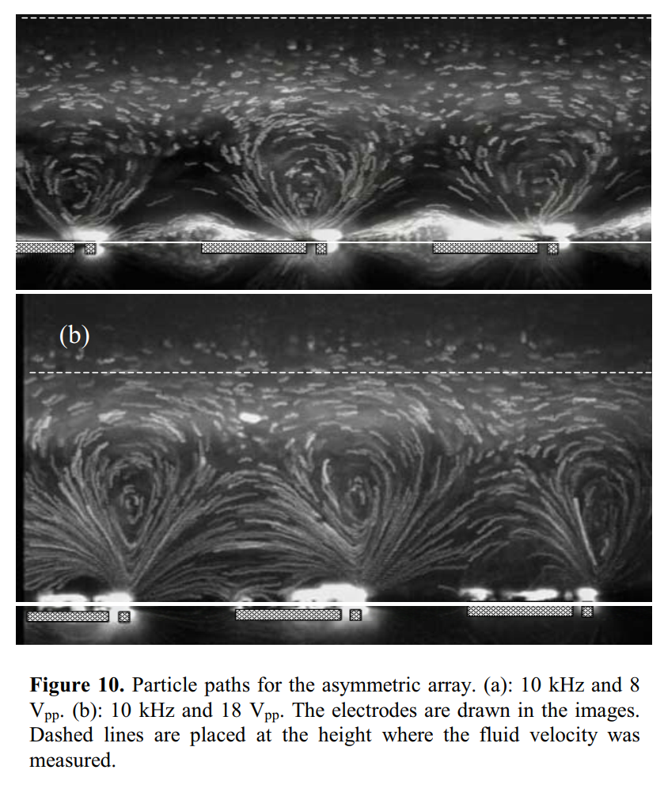
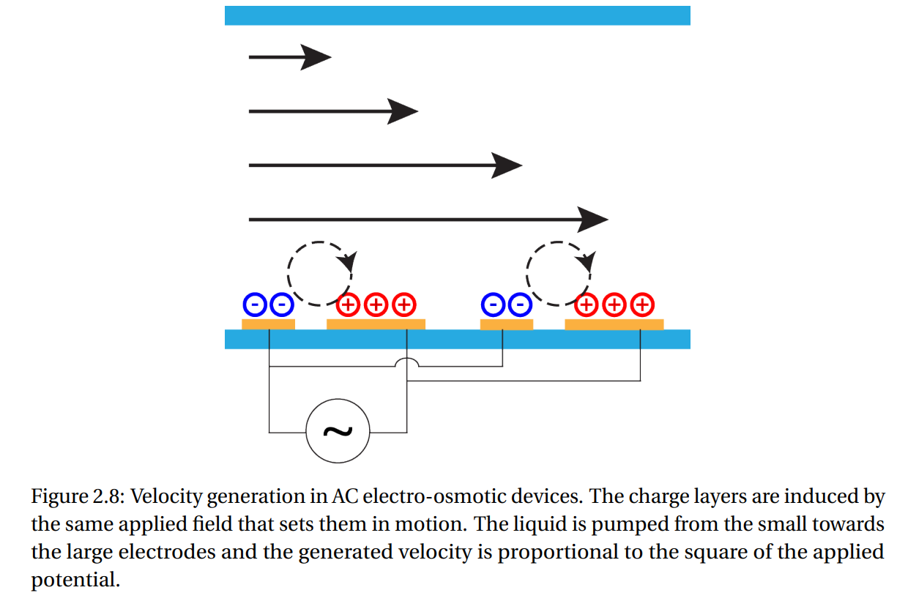
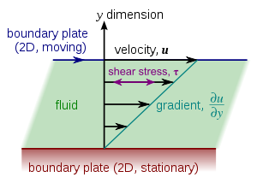
Flow pattern（A2）
Used to verify the flow pattern stated on the left-hand side.
Couette flow
L=100μm，S=10μm，G1=10μm，G2=100μm
When the large electrode is as wide or wider than the channel depth, the rolls will occupy the entire cross-section of the channel.
Ref[147]: The vertical limitation of the ACEO flow should result in an increase of the mean velocity in the portion of the channel without electrodes.
Notes:
Fig. 2.8 Microfabricated All-Around-Electrode AC Electro-osmotic Micropump
Fig. 10 P. García-Sánchez, A. Ramos, N. G. Green and H. Morgan, “Experiments on AC Electrokinetic Pumping of Liquids Using Arrays of Microelectrodes”
Methods to take pictures:
1. microscope & camera from above and side of the electrodes.
2. Flow tracers：Fluorescent latex particles 荧光乳胶粒 (500 nm diameter) were suspended in the electrolyte.
Couette flow:
Describe a viscous fluid flowing between two surfaces, one of which is moving tangentially relative to the other.
The relative motion of the surfaces imposes a shear stress(F/A) on the fluid and induces flow.
F: viscous drag粘性阻力
A: the cross-sectional area of material/fluid

Slide 5
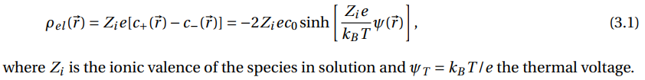



Discussion 2 (Base for the Velocity model)
Charge distribution->potential
Boltzmann distribution
ion concentration -> c₀
Electrical potential = 0.
Positive ions concentrations c₊
Negative ions concentrations c₋
Vector r: the distance r from the wall.
Poisson equation
Poisson-Boltzmann equation (PB) (Gouy-Chapman (GC) equation )
Notes:
Citation for the equations:
Microfabricated All-Around-Electrode AC Electro-osmotic Micropump
Poisson equation:
Describe the relationship between charge density and electrical potential in a volume.
Given a charge density in a volume, the potential will vary as the function shown above.
The solution to Poisson's equation is the potential field caused by a given electric charge or mass density distribution;
with the potential field known, one can then calculate electrostatic or gravitational (force) field.

Slide 6
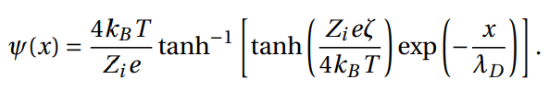
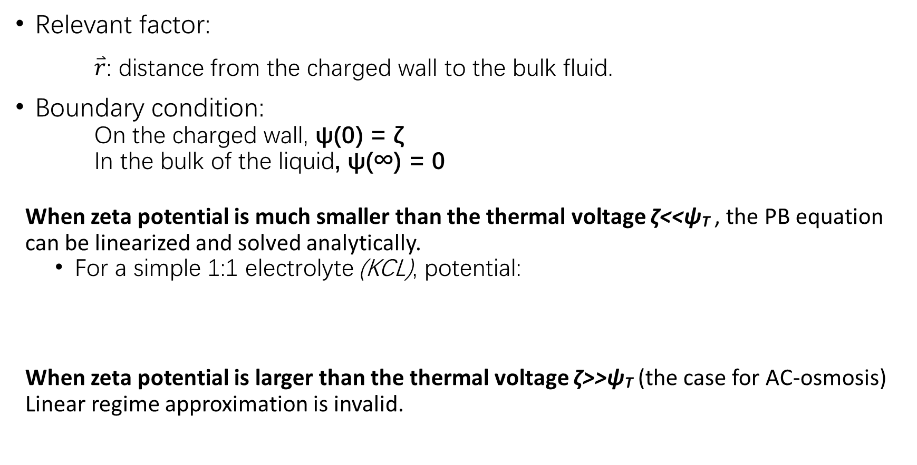
Poisson-Boltzmann equation (PB)
Relevant factor:
$\overset{⃑}{r}$: distance from the charged wall to the bulk fluid.
Boundary condition:
On the charged wall, ψ(0) = ζ
In the bulk of the liquid, ψ(∞) = 0
When zeta potential is much smaller than the thermal voltage ζ<<ψ_{T} , the PB equation can be linearized and solved analytically.
For a simple 1:1 electrolyte (KCL), potential:
When zeta potential is larger than the thermal voltage ζ>>ψ_{T} (the case for AC-osmosis) Linear regime approximation is invalid.
Notes:
Steric limit (Steric effects):
Because of the increase potential of the wall, more ions will be attracted to the walls, and the local charge concentration will be affected by their dimensions.
立体效应: 分子本身各个官能团客观上占据了一定的空间大小，由此产生的诸多影响，比如相互的挤压，称为立体效应。

Slide 7
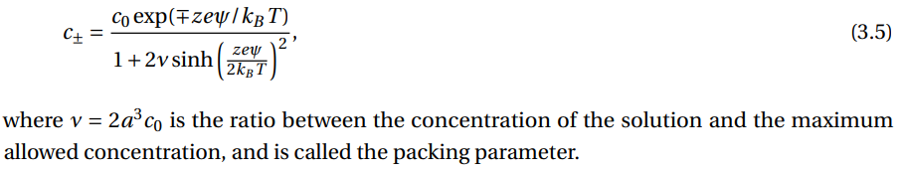
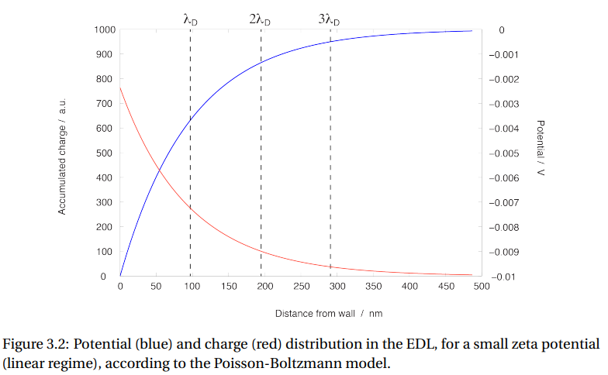
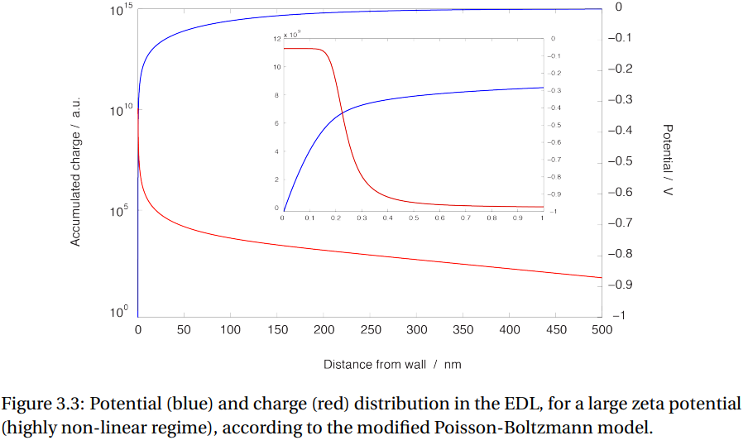
Modified Poisson-Boltzmann equation (MPB)
PB
MPB
Notes:
Citation for the figures:
Microfabricated All-Around-Electrode AC Electro-osmotic Micropump
Figure3. use FEM 有限元分析 计算结果
？Why we use PB instead of MPB?

Slide 8
Why we use PB here instead of MPB?
The original paper which we referred to didn’t consider the situation for MPB, limited by the published time.
The PB model for the velocities’ simulation explained the observation from the experiment well, but not that accuracy.
MPB is more complicated for solving the potential solution, need to use COMSOL or other tools to solve.

Slide 9
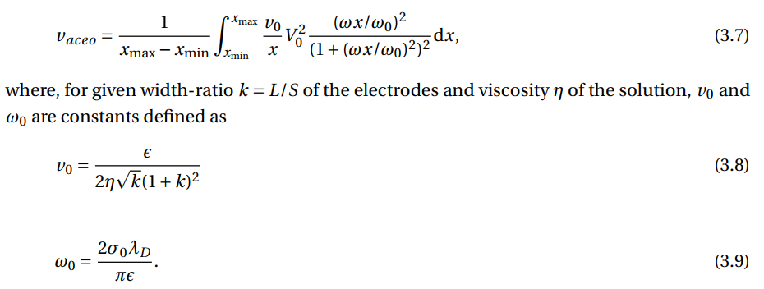
Velocity model (updated)
ACEO flow velocity (on the surface of the electrodes)
To obtain the velocity of the bulk fluid in the middle of the channel
Notes:
Vave: Page 65,
Microfabricated All-Around-Electrode AC Electro-osmotic Micropump

Slide 10
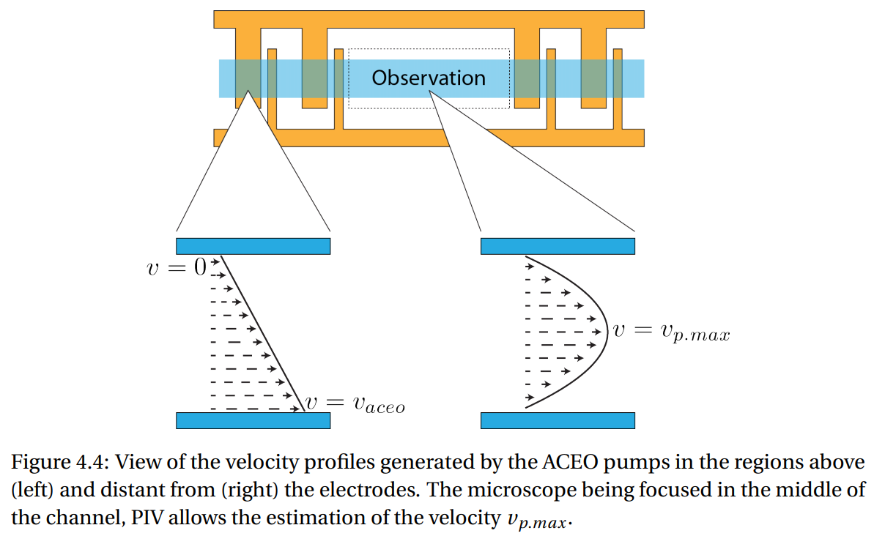

Poiseuille flow
Observed velocity vs. ACEO velocity on the electrode surface
Couette flow
α coefficient that accounts for the shape of the channel cross-section
β = ，accounts for the average velocity of the ACEO flow
L_{el} The extent of the electrodes along the channel
L_{tot} The total length of the channel
Notes:
Page 81.

Slide 11
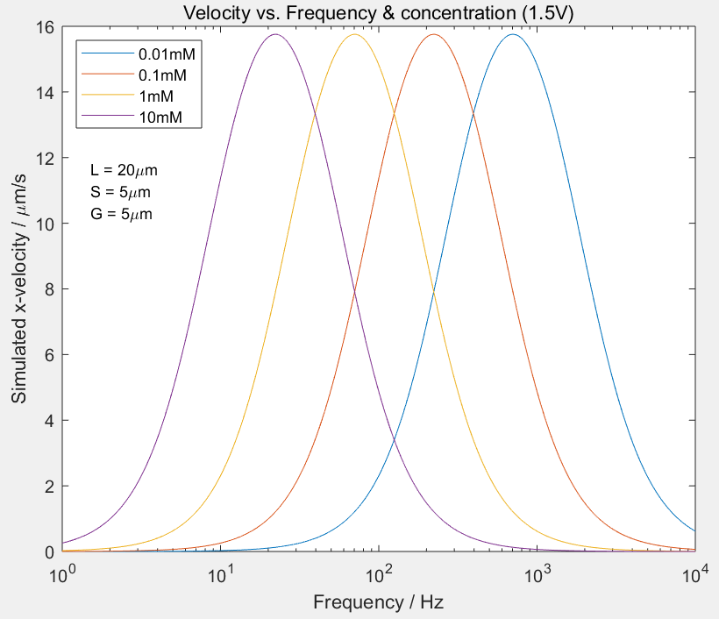
Dependencies (II. frequency & concentration) MATLAB simulation
When the concentration increases, the optimal frequency of the system decreases.

Slide 12
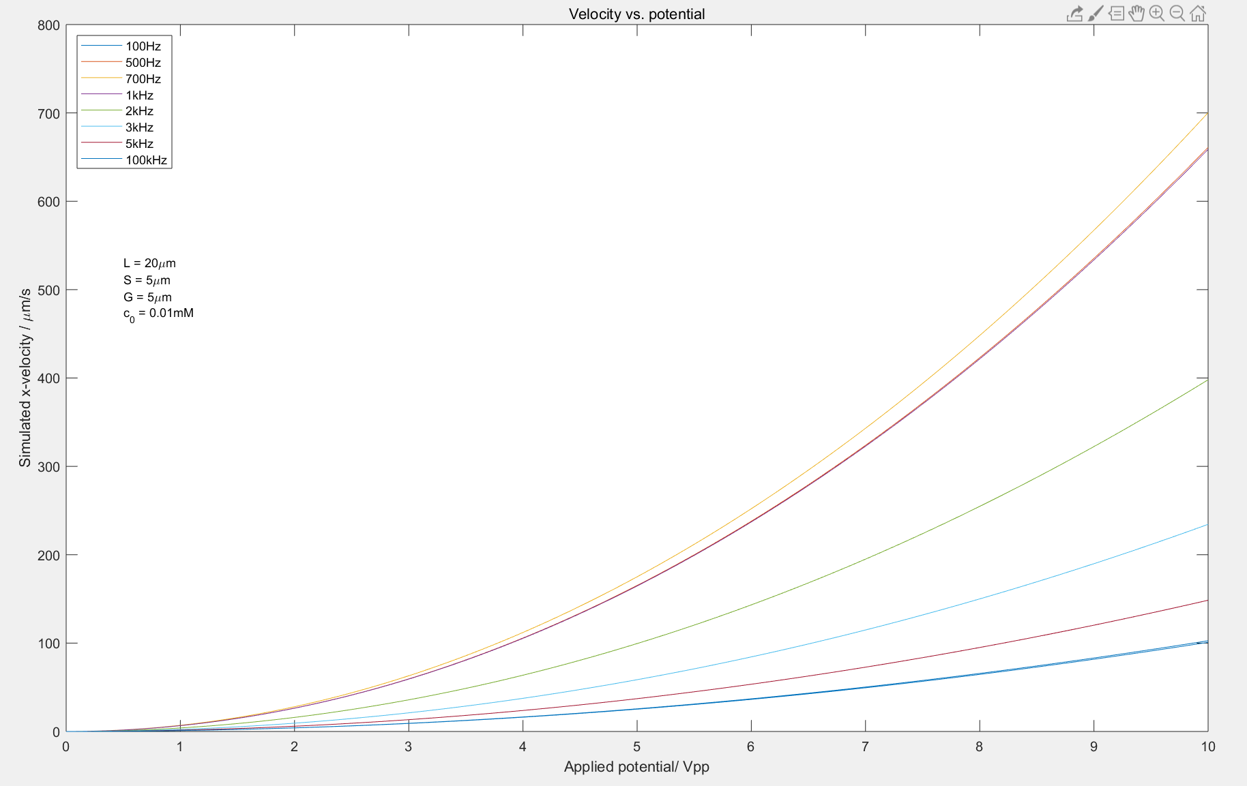
Dependencies (III. frequency & applied potential) MATLAB simulation
Large potential generate large velocity.
v is proportional to ψ²
Different electrodes’ dimension will have different optimal frequency, which is determined by the over all impedance of the ACEO system [ref].
Here the optimal frequency is about 700Hz.
When the frequency is quite large, the velocity will decrease until to zero (see slide page 2)
Still need to find the optimal frequency by calculating the impedance of the system.
Notes:
[Ref] page 68. Microfabricated All-Around-Electrode AC Electro-osmotic Micropump

Slide 13
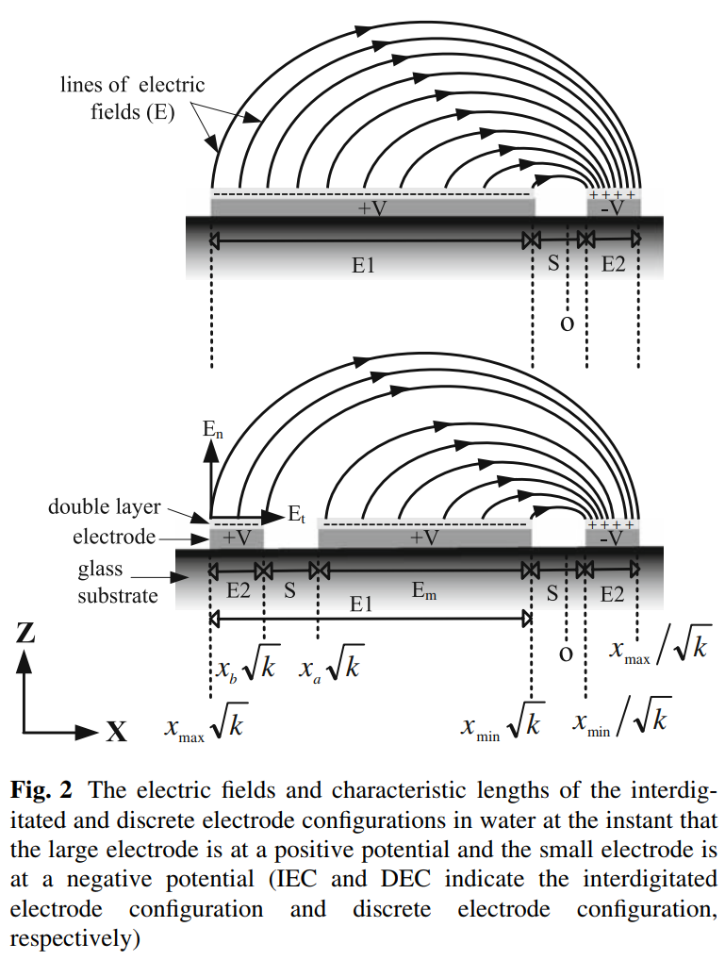
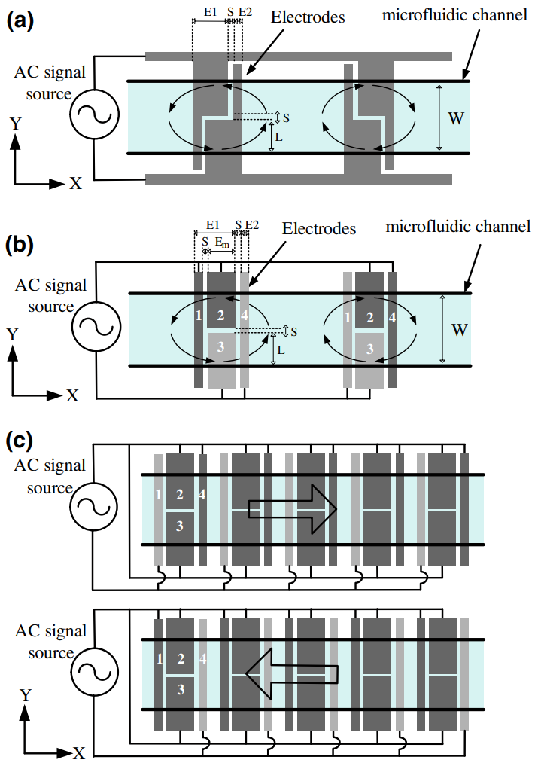
Extended info.
Reversal of the flow achieved by grouping the electrodes.
E1 = 100 μm
E2 = 20 μm
k = 5
S = 20 μm
100 pairs
Large gap: 400μm
x_{min} = 7.5μm
x_{a} = 42.1μm
x_{b} = 47.5μm
x_{max} = 52.2μm
λ_{D} = 100nm
200nm thick gold electrodes
Channel width: 600μm
Channel depth: 200μm
Channel length: 5cm
Notes:
“Configurable AC electroosmotic generated in-plane micro vortices and pumping flow in microchannels”, Shih-Hao Huang Æ Hui-Jung Hsueh Æ Kuo-Yung Hung

Slide 14
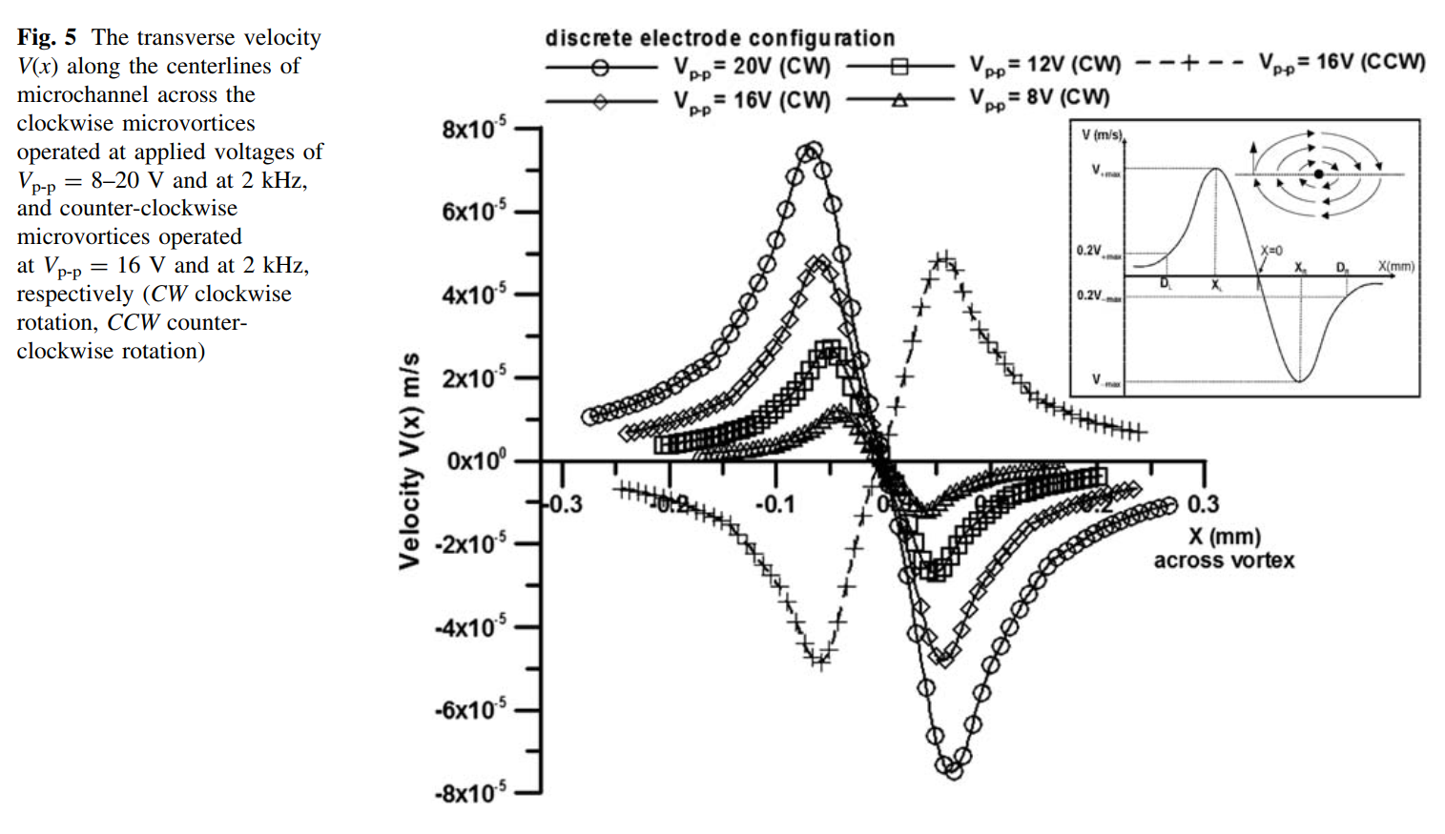

Slide 15
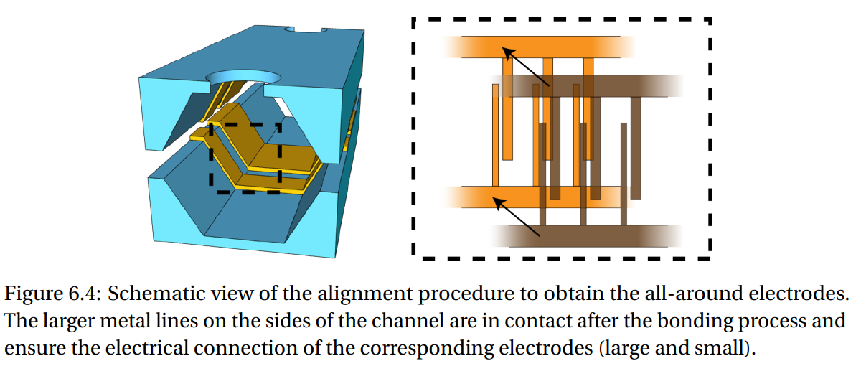
Extended info. All-rounded electrodes
Notes:
Microfabricated All-Around-Electrode AC Electro-osmotic Micropump
Chapter 6-7

Slide 16
